Slide 1


Quant/Risk Report
Georgio Najm
and
Tevin Parathattal
September 22, 2025

Slide 2
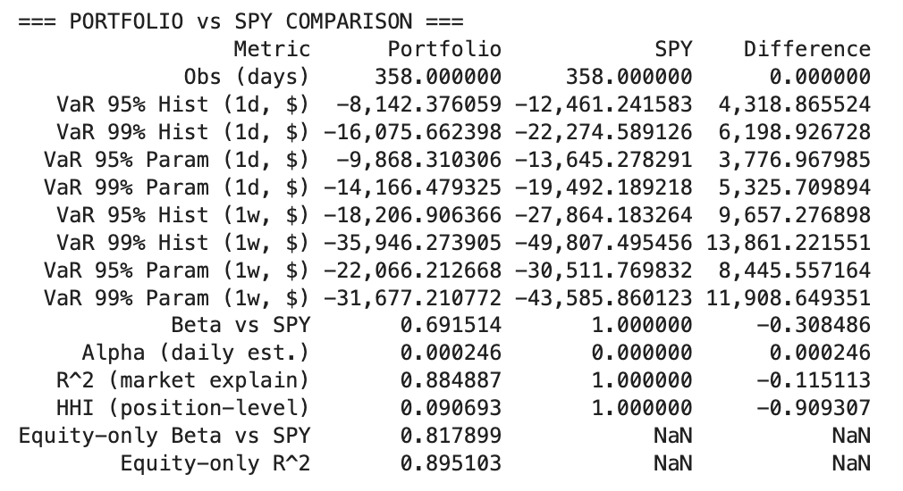
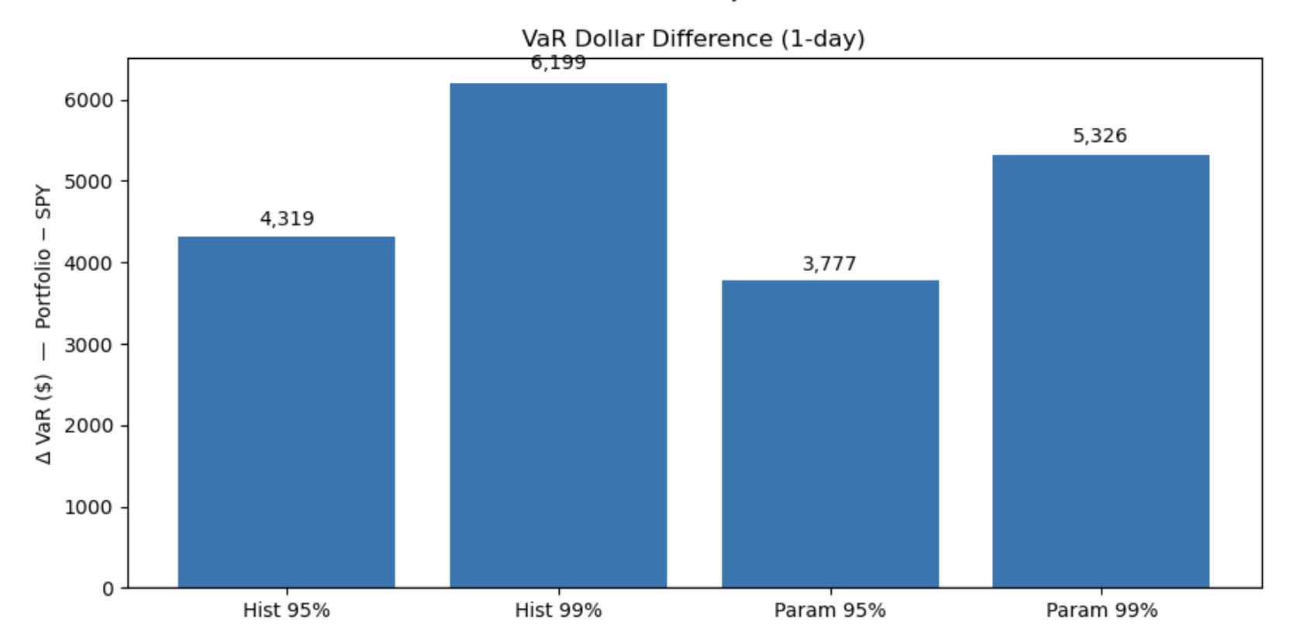
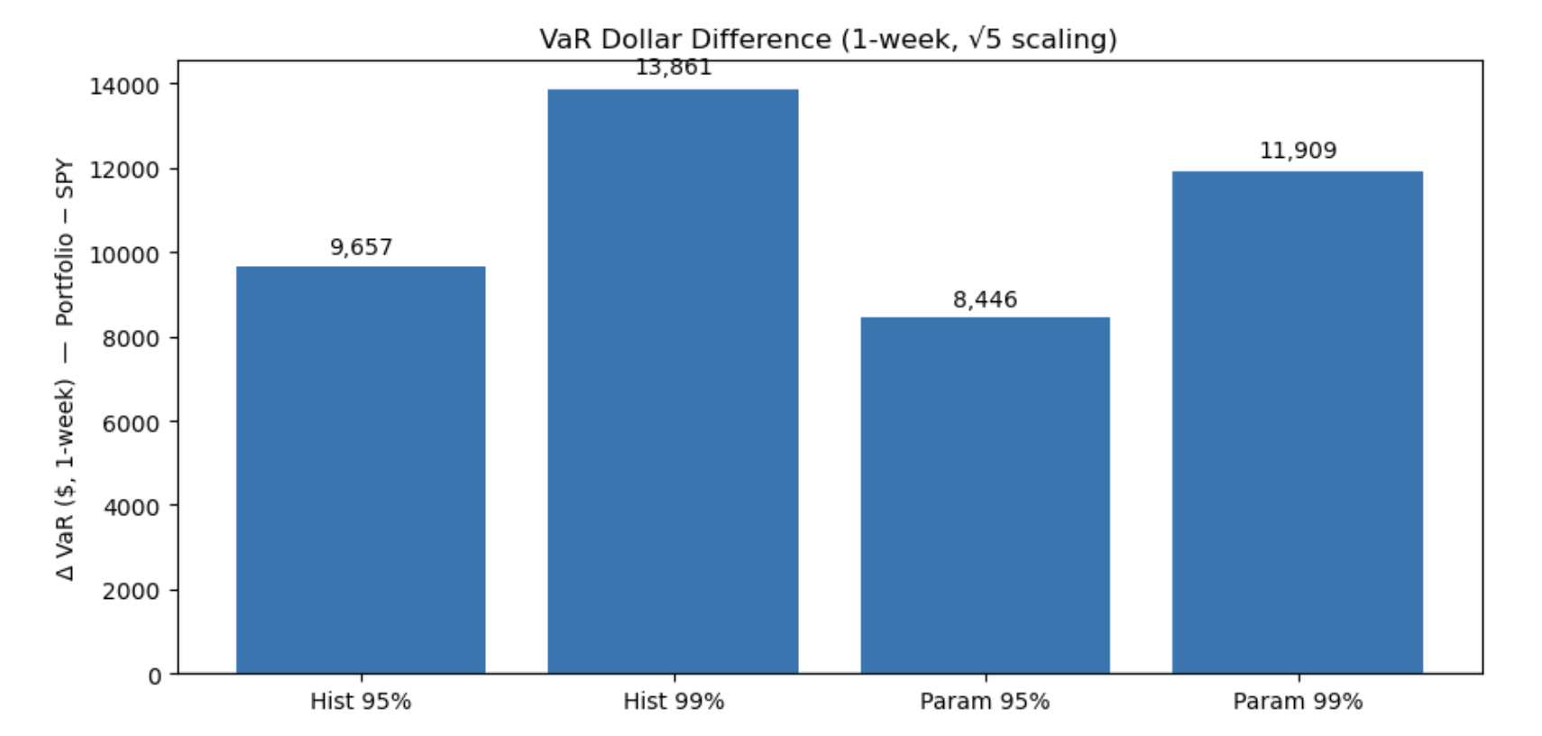
SPY vs SMIF Portfolio VaR

Slide 3
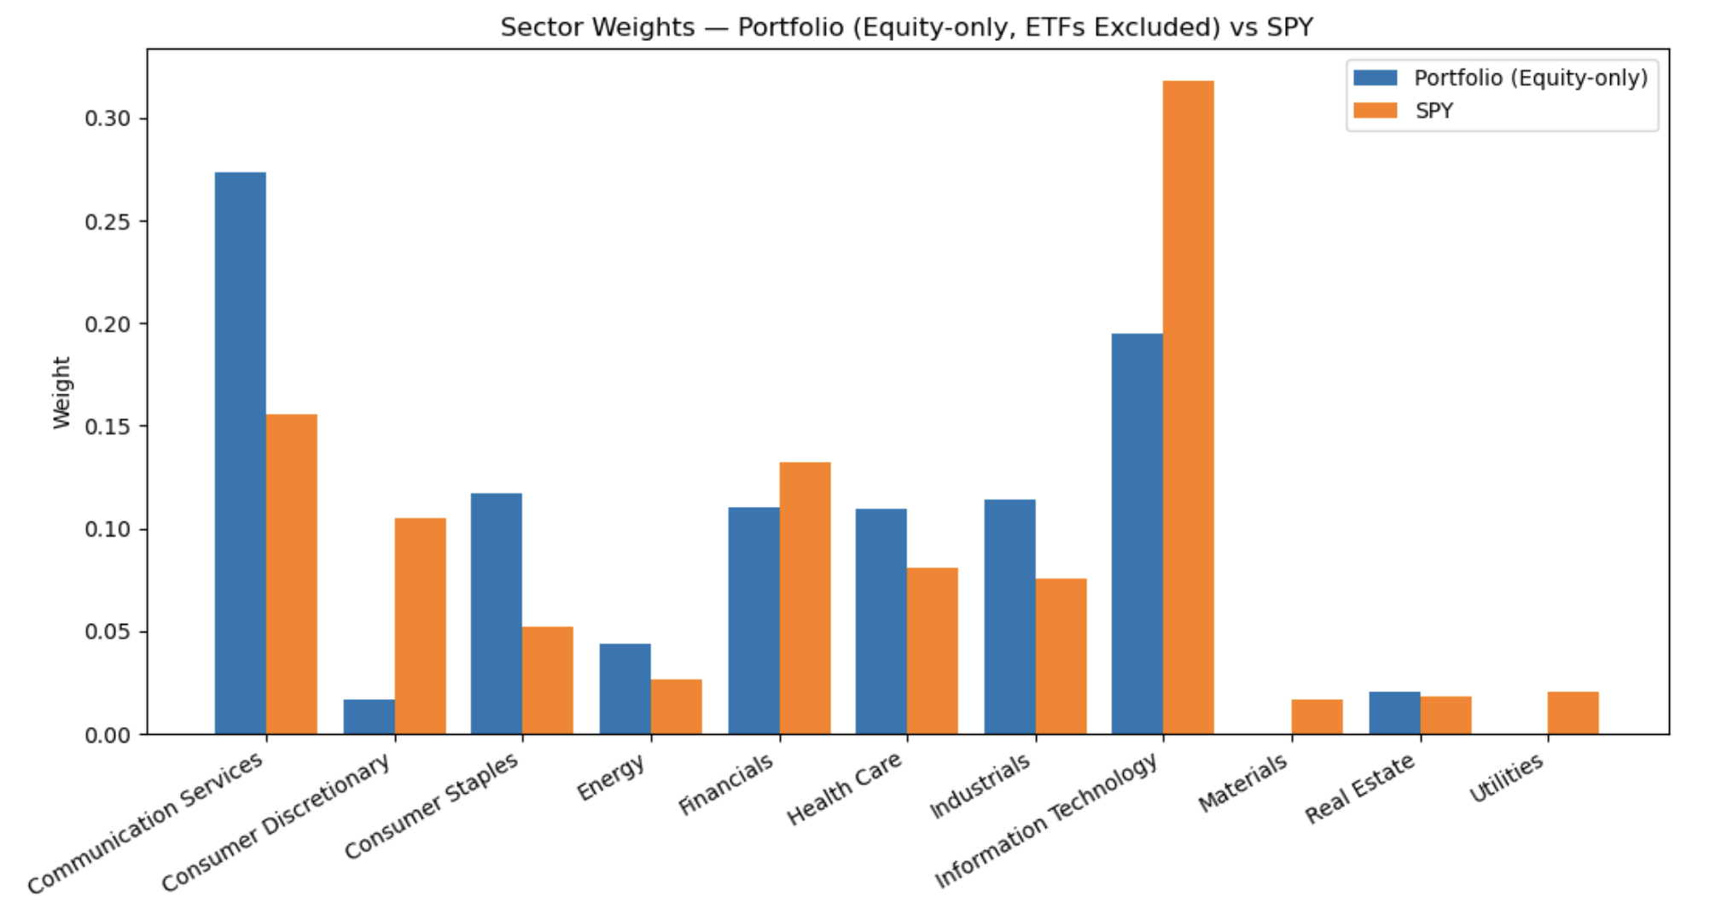
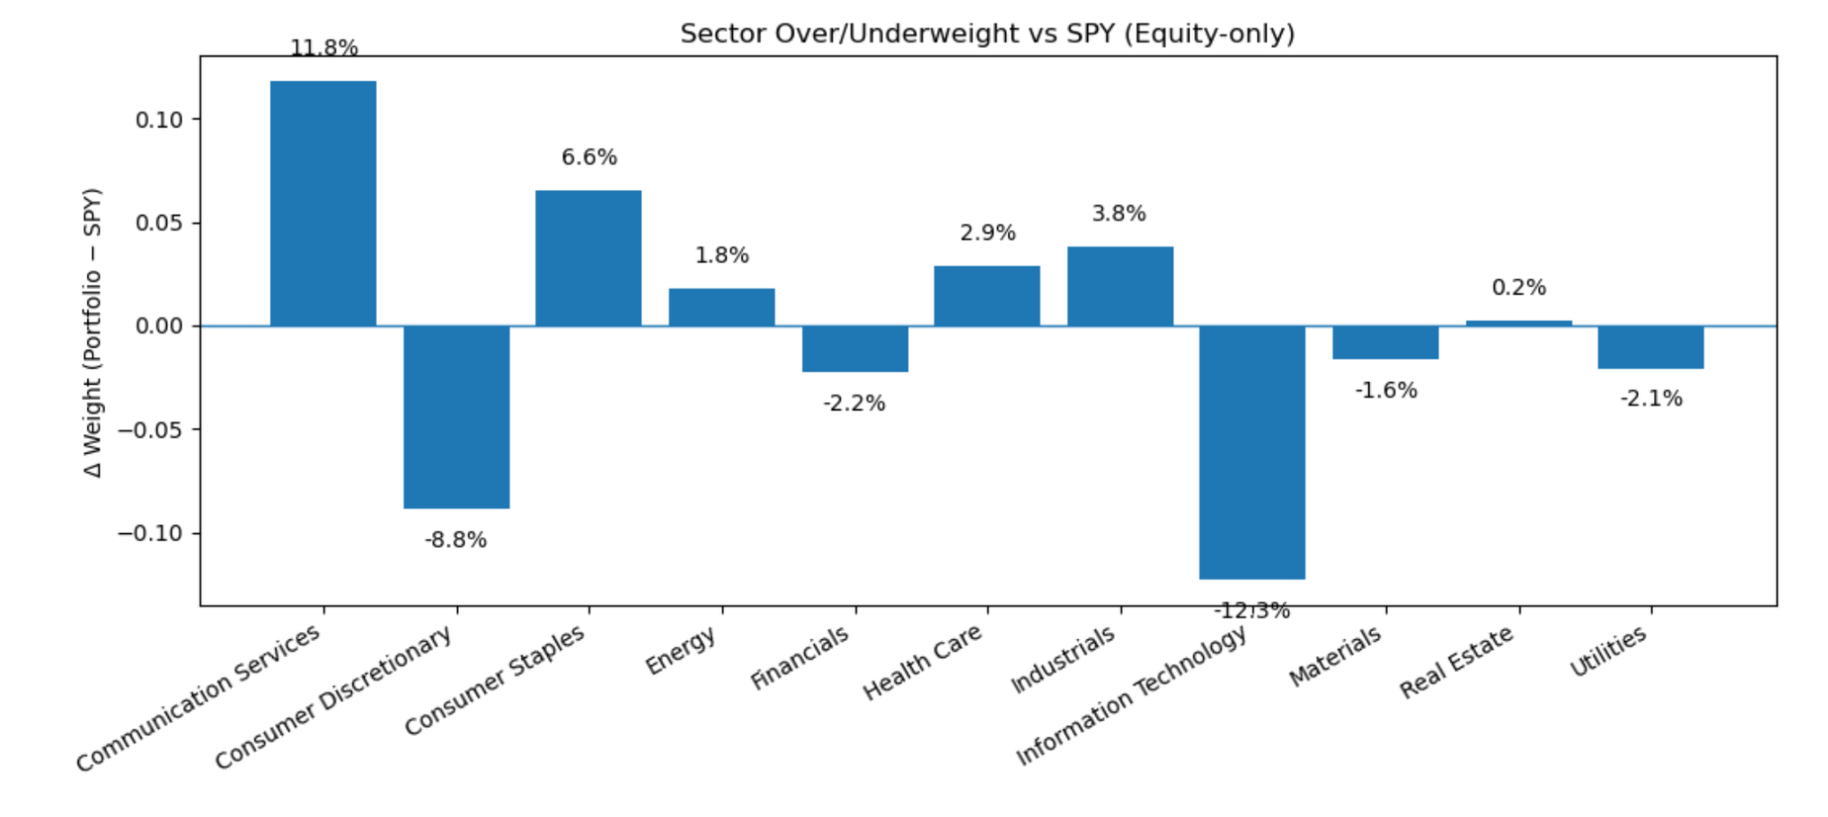
SPY vs SMIF Sector Breakdown

Slide 4
Why Risk & Alpha Matter
Core question: Are our returns driven by skill (true alpha) or just by systematic exposures?
Why it matters: Misattributed alpha = overconfidence in strategies, hidden risks to the fund.
Today’s agenda:
Risk metrics: Beta, R², Value-at-Risk (VaR), concentration, and sector tilts.
Alpha frameworks: CAPM → Fama–French 3-factor → Fama–French 5-factor →
Goal for SMIF: Build a disciplined process to separate intentional bets from unintended risk exposures.

Slide 5

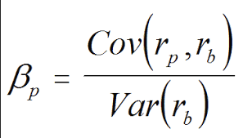
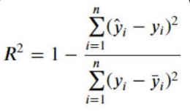
Risk Metrics - Beta
Interpretation:
β > 1 → portfolio more volatile than market
β < 1 → portfolio less volatile (defensive)
Our Result: β ≈ 0.82 → we’re less volatile than SPY
Implication: Even when market swings, our portfolio moves less.

Slide 6
Risk Metrics - R²
SSE = unexplained variation
SST = total variation
Interpretation: Proportion of portfolio returns explained by the model (market, factors, etc.).
Our Result: R² ≈ 0.895 → 89.5% of our portfolio’s movement is explained by SPY.
Implication: Only ~12% could be due to stock-picking skill or unique bets.

Slide 7
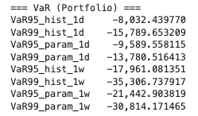
Value at Risk
Concept: “What’s the most we might lose, with X% confidence, in 1 day/week?”
Methods:
Historical (percentiles of actual returns)
Parametric (assuming normal distribution)
Our Result:
95% 1-day VaR ≈ –$8K
99% 1-day VaR ≈ –$16K
Implication: Tail losses are meaningful, especially in high-volatility regimes.

Slide 8
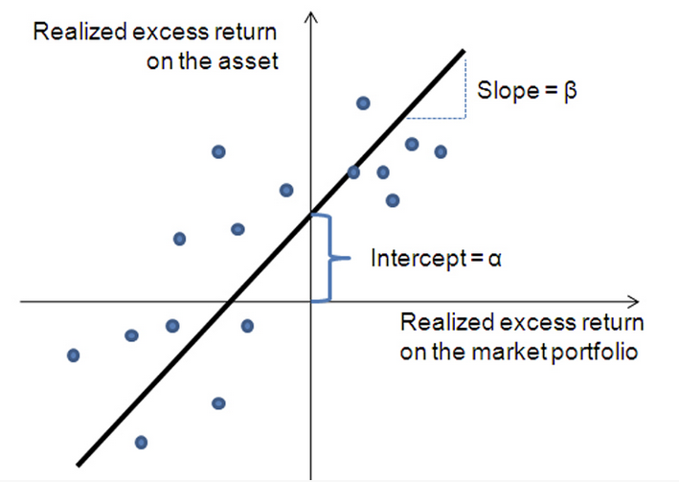
Alpha - Why Alpha Matters
Beta, R², VaR = risk side.
Next: Are we delivering returns above what risk exposures predict?
Roadmap: CAPM alpha → FF3 → FF5 → q-factor.
Big Question: Is our performance true stock-picking skill or just factor tilts?

Slide 9
Introduction to CAPM Alpha
Expected return = Risk-free rate + β × (Market return – Risk-free).
Alpha = Extra return beyond CAPM prediction.
Think of it as the “skill” or “edge”:
α > 0: Outperformed what risk exposure explains.
α = 0: Matched the market, no edge.
α < 0: Underperformed, even after adjusting for risk.
Why it matters: Separates luck (beta exposure) from manager skill.

Slide 10
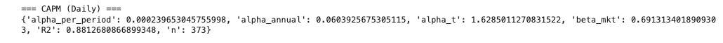
CAPM Alpha
Alpha ≈ +6% annualized → small but positive (barely significant, t ≈ 1.6)
Beta ≈ 0.69 → we’re less volatile than the market
R² ≈ 0.88 → most of our returns explained by SPY (not pure stock-picking)
Interpretation: CAPM says we’re slightly beating the market.

Slide 11


WHO ARE FAMA & FRENCH?
Eugene Fama
Professor of Finance, University of Chicago Booth School of Business
Known as the “Father of the Efficient Market Hypothesis”
Awarded the 2013 Nobel Prize in Economics for his work on asset pricing.
Kenneth French
Professor of Finance, Dartmouth College Tuck School of Business
Research focus on asset pricing, portfolio theory, and risk management
Recognized as one of the most influential voices in modern finance

Slide 12
Quick Introduction to the Fama-French Models
Fama–French 3-Factor (FF3)
Market (MKT-RF): The excess return of the market over risk-free.
Size (SMB = Small Minus Big): Small-cap stocks outperform large-caps, on average.
Value (HML = High Minus Low): Value stocks (high book-to-market) outperform growth stocks.
Fama–French 5-Factor (FF5)
Profitability (RMW = Robust Minus Weak): Profitable firms outperform weak ones.
Investment (CMA = Conservative Minus Aggressive): Firms that invest conservatively outperform heavy-investment firms.
If we control for common knowledge, how good are you?

Slide 13
Fama-French 3 Factor Model
Alpha ≈ –5% annualized → underperforms once size/value factors are controlled
MKT-RF beta ≈ 0.71 → still strongly tied to the market
SMB beta ≈ +0.43 → tilted toward small-cap/growth exposure
HML beta ≈ –0.72 → heavily tilted against value (i.e., toward growth stocks)
R² ≈ 0.65 → less variance explained vs. CAPM (model shows tilts matter more than market alone)
Interpretation: Once factor tilts are accounted for, “alpha” disappears → our “skill” looks like a growth/small-cap tilt, not pure stock-picking.

Slide 14
Fama-French 5 Factor Model
Alpha ≈ –5% annualized → portfolio underperforms once size, value, profitability, and investment factors are stripped out.
Factor exposures:
SMB (+0.41) → tilted toward smaller stocks.
HML (–0.90) → strongly tilted toward growth (anti-value).
RMW (–0.21) → low-profitability tilt.
CMA (+0.20) → slight conservative investment tilt.
R² ≈ 65% → most of our returns explained by common factors, not unique stock-picking.

Slide 15
Q-Factor Model
Developed by Hou, Xue, and Zhang (2015) as an alternative to Fama-French
Grounded in investment-based asset pricing theory rather than pure empirical anomalies
Four factors:
Market (broad market excess return)
Size (small minus big)
Investment (conservative vs. aggressive firm investment)
Profitability (robust vs. weak operating profitability)
Interprets anomalies as outcomes of firm decisions on investment and profitability
Claims greater parsimony and theoretical foundation than Fama-French
Alpha represents true stock-picking skill after controlling for these economic drivers
Notes:
Companies make choices: how much they invest, how much profit they generate.
Those choices affect their stock returns in predictable ways.
The Q-factor model says:
Stocks move with the market.
Small companies behave differently from big ones (size).
Companies that invest cautiously (don’t blow cash on projects) do better than aggressive spenders (investment).
Companies that make strong profits beat weak ones (profitability).
If you’re making money just by holding profitable, conservative firms, that’s not skill—that’s just loading on these factors.
Alpha here = did you earn money that can’t be explained by market, size, investment, or profitability?
👉 Think of it like stripping excuses away:
CAPM says: “You only beat the market if you dodge beta.”
Fama-French says: “Nope, also no extra points for picking small or cheap stocks.”
Q-Factor says: “And don’t act like buying profitable or conservative-investment firms is skill either.”

Slide 16
Q-Factor Model
Alpha (monthly): –0.43% → Portfolio underperforms the Q-factor model by ~0.43% per month
Alpha (annualized): –5.12% → That compounds to about –5% per year of “negative skill” after accounting for factors
Alpha t-stat: –33.9 → Extremely statistically significant
Market Beta (MKT = 1.33) → Portfolio is more volatile/risk-exposed than the market
Size loading (ME = –0.45) → Tilts toward large-cap stocks (negative on small-minus-big factor)
Investment loading (IA = 0.02) → Basically neutral exposure to conservative vs aggressive investors
Profitability loading (ROE = –0.96) → Tilted away from high-profit firms (more weight on low-profitability firms)
R² = 0.73 → About 73% of the returns are explained by these factors; the rest is idiosyncratic noise
n = 10 → Regression is based on 10 monthly observations
Notes:
Companies make choices: how much they invest, how much profit they generate.
Those choices affect their stock returns in predictable ways.
The Q-factor model says:
Stocks move with the market.
Small companies behave differently from big ones (size).
Companies that invest cautiously (don’t blow cash on projects) do better than aggressive spenders (investment).
Companies that make strong profits beat weak ones (profitability).
If you’re making money just by holding profitable, conservative firms, that’s not skill—that’s just loading on these factors.
Alpha here = did you earn money that can’t be explained by market, size, investment, or profitability?
👉 Think of it like stripping excuses away:
CAPM says: “You only beat the market if you dodge beta.”
Fama-French says: “Nope, also no extra points for picking small or cheap stocks.”
Q-Factor says: “And don’t act like buying profitable or conservative-investment firms is skill either.”

Slide 17
QUESTIONS?

